Slide 1


Slide 2
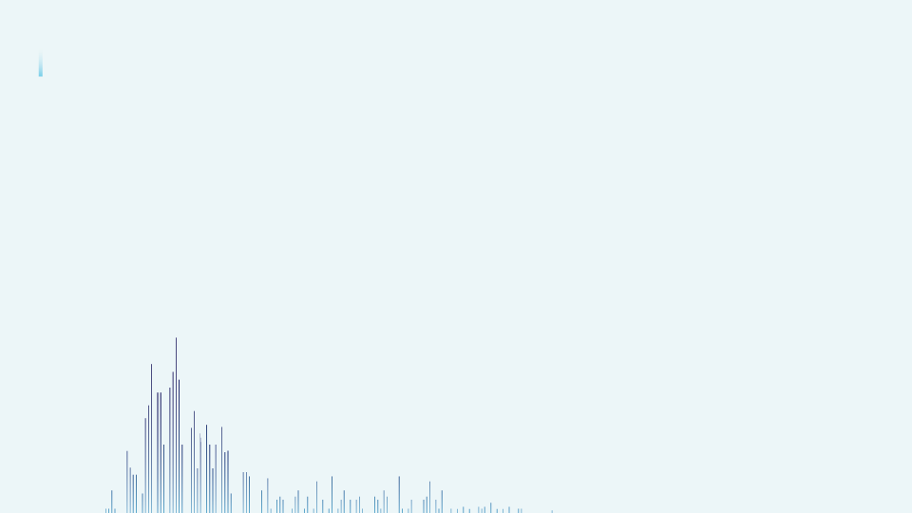

Project Domain : Retail Title: Customer Segmentation Analysis for Online Retail Store Sales Subtitle: Capstone Project Presentation Name : Pujesh Bhardwaj Date : 23rd Sept 2023

Slide 3
Introduction
Dataset : It is a transnational data set which contains all the transactions occurring between 01/12/2010 and 09/12/2011 for a UK-based and registered non-store online retail. (source - Dr Daqing Chen, Director: Public Analytics group. chend '@' lsbu.ac.uk, School of Engineering, London South Bank University, London SE1 0AA, UK.)
Problem Statement : Large & primary raw data - Finding Key insights and customer segmentation for better marketing strategies and program
Objective : Retail customer segmentation - EDA, Data Cleaning, Clustering(K-means clustering) , Data Visualization - Dashboard KPI’s.
Customer Segmentation and its Significance

Slide 4
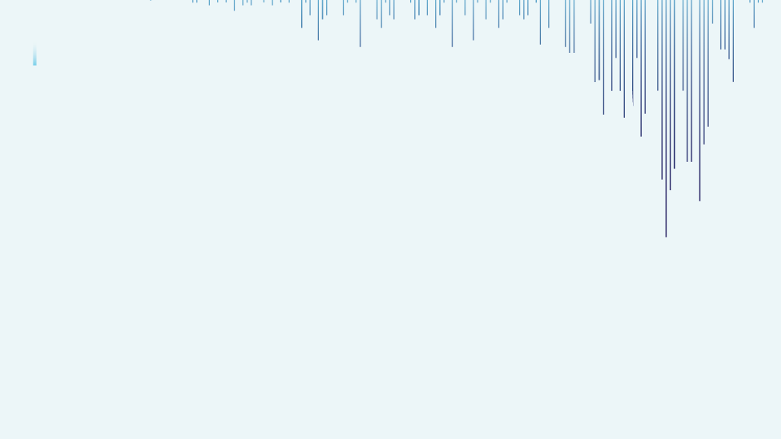
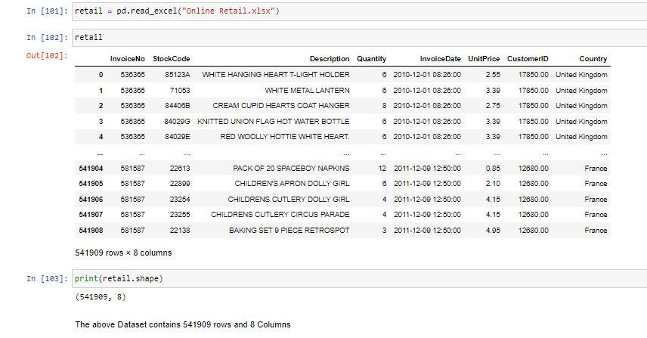
Data Overview
Dataset contains 8 attributes
Shape : 541909 rows and 8 columns
Only have CustomerID to work on customer segmentation.
Key variables – Stock code, Quantity, Unit Price
.
Fig.1

Slide 5
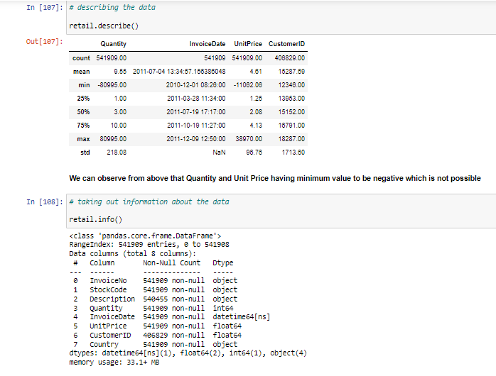
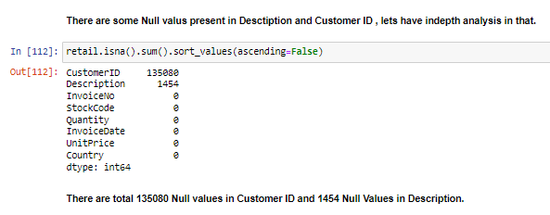
Describing our Data for statistical Analysis – min value of quantity and unit price are incorrect
Taking information about data – There can be noticed some null values in Description and Customer ID column
Fig 3
Fig 2

Slide 6
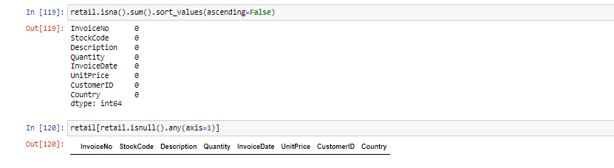
Data Cleaning
Data cleaning - Crucial for analysis
Challenges encountered during data cleaning

Slide 7
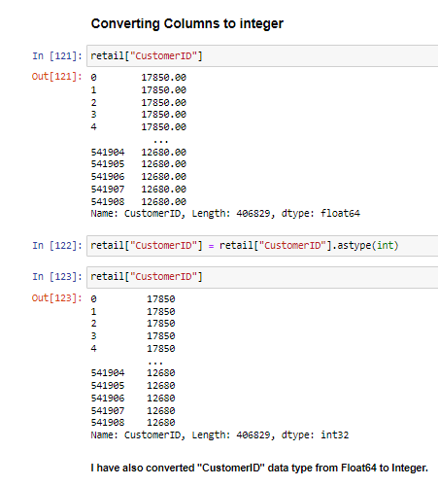
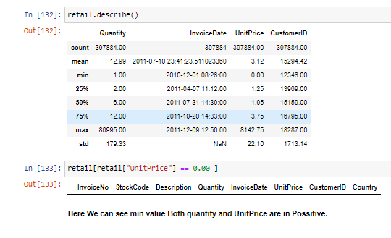
Converting suitable data type for ease in further analysis
Checking data quality issues - min value of Quantity and Unit Price column
Fig 5
Fig 4

Slide 8
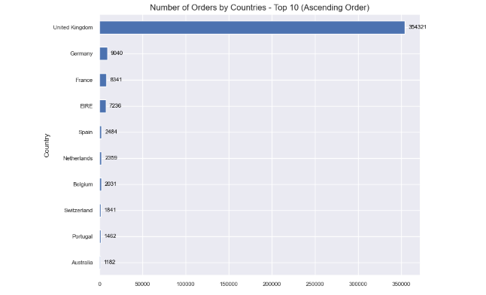
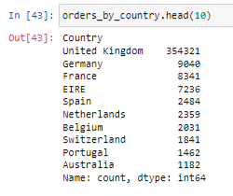
Exploratory Data Analysis (EDA)
Summarizing, visualizing, and understanding key characteristics and patterns in data to gain insights.
Number of orders for different countries
UK , Germany France are the top among top 10 countries in terms of total orders.
UK with significant higher with 354k orders compared to 2nd highest Germany with 9040
Fig 7
Fig 6

Slide 9
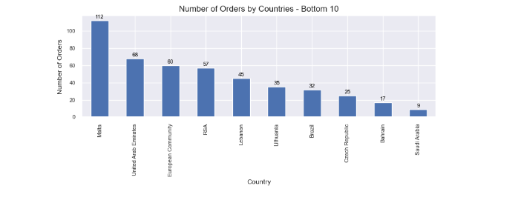
EDA
Similarly Saudi Arabia, Bahrain & Czech Republic have lowest orders among bottom 10 countries with Saudi Arabia to be lowest 9 orders.
Fig 8

Slide 10
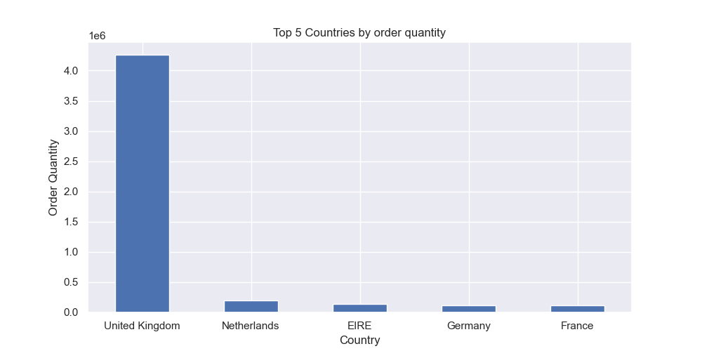
EDA
In quantity also UK tops with 4.25 million units in total.
UK, Netherland, EIRE, Germany and France are among top 5 countries by order quantity.
It is noticeable that Ned and EIRE are ahead of Germany and France in order quantity even when they have less orders
It will be interesting to compare their revenue in further analysis.
Fig 9

Slide 11
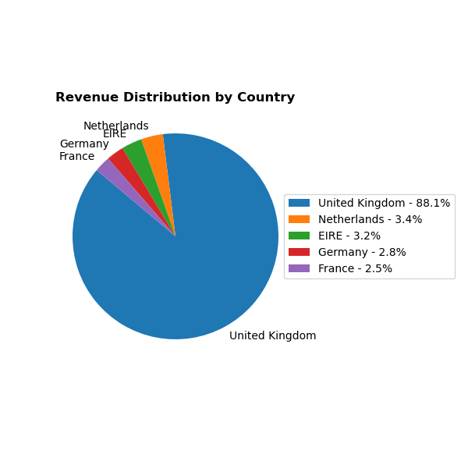
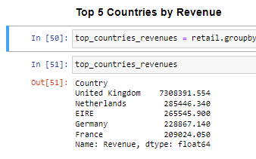
EDA
In revenue contribution also UK is the highest followed by Ned and EIRE
Germany and France are again generating less revenue compared to number of orders than Ned and EIRE
Fig 11
Fig 10

Slide 12
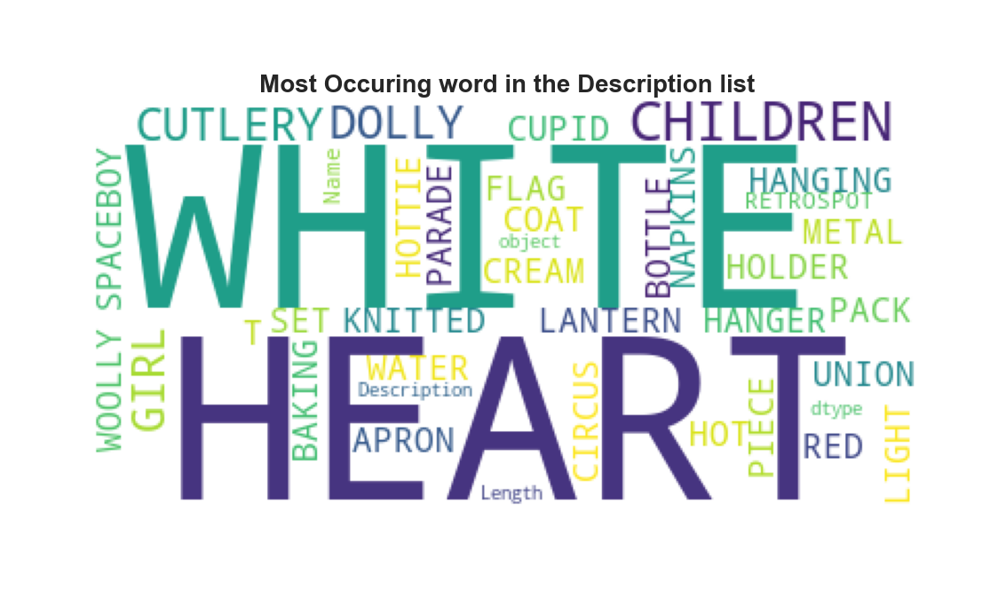
EDA
From Description column used word cloud to show most repeated word or key word of order description.
This analysis can be further more helpful for SEO and SEM in digital marketing strategy.
Fig 12

Slide 13
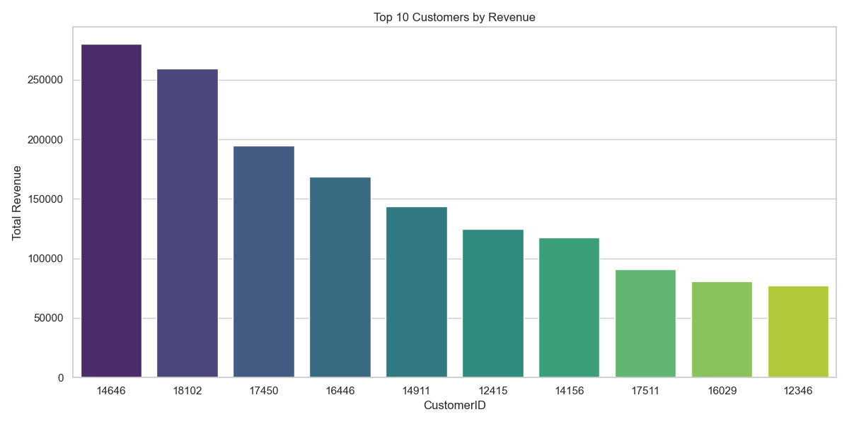
EDA
Top customer with customer ID - 14646 have highest revenue of 280k Pound.
On further analysis it is observed that this this customer is from Netherlands.
Fig 13

Slide 14
Customer Segmentation
K-means Clustering
Unsupervised machine learning technique.
Groups similar data points into clusters.
Each data point assigned to the nearest cluster center (centroid)
Minimize the sum of squared distances (SSD) between data points and their cluster centroids.
Sensitive to outliers

Slide 15
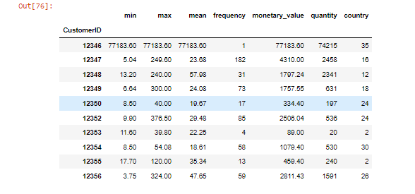
Customer Segmentation
Feature Selection
Created a grouped dataset by Customer ID
Date and Revenue attribute for feature selection and converted Date into frequency and Revenue into monetary value by each customer.
This Finally merged group data with full data.
Fig 14

Slide 16
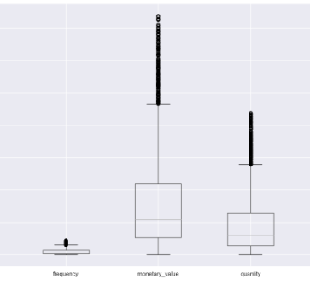
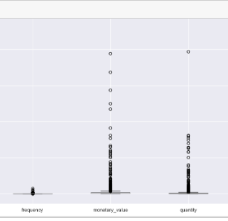
Customer Segmentation
Outliers check and removal
Since K-means clustering is sensitive to outliers so it is important to remove them.
In right box plot there are outliers visible
In left side box we have removed the outliers
Outliers Removed
Outliers

Slide 17
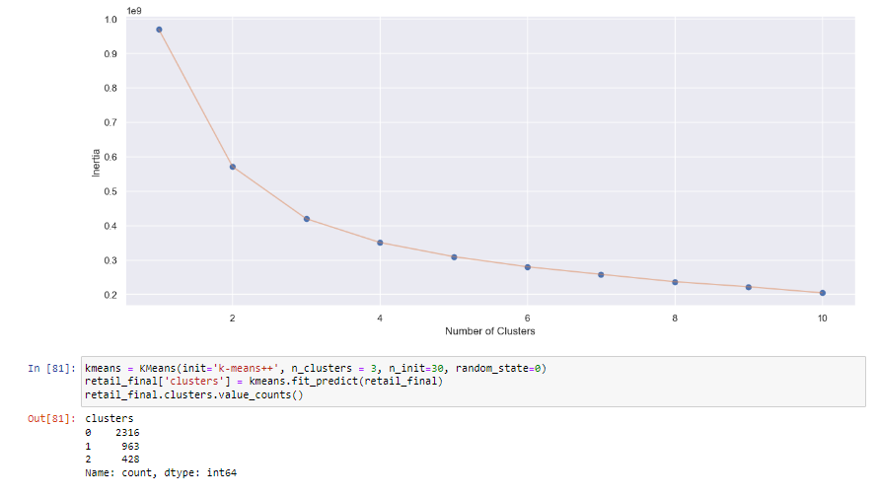
Customer Segmentation
Choose the Number of Clusters (K)
Used elbow plot method to choose find number of clusters K.
As the graph indicates "elbow" point where SSD/Inertia starts to level off at 3.
This gives K value to be 3, i.e. we will consider 3 clusters for customer segmentation.
Fig 15

Slide 18
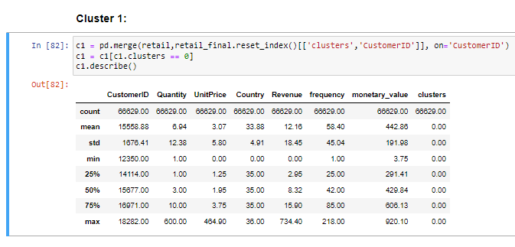
Interpretation of Segments
Cluster -1
Describing Cluster-1 for statistical analysis
Average Order Quantity of 6.94.
Average Unit price of 3.07.
Average Revenue of 12.16.
Average Frequency of 58.
Average Monetary value of 442.86.
Fig 16

Slide 19
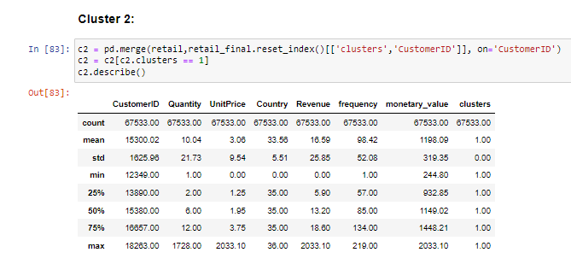
Interpretation of Segments
Cluster - 2
Describing Cluster-2 for statistical analysis
Average Order Quantity of 10.4.
Average Unit price of 3.06.
Average Revenue of 16.59.
Average Frequency of 98.42.
Average Monetary value of 1198.09.
Fig 17

Slide 20
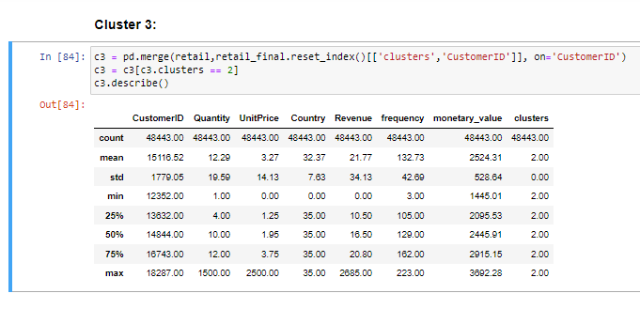
Interpretation of Segments
Cluster - 3
Describing Cluster-3 for statistical analysis
Average Order Quantity of 12.29.
Average Unit price of 3.27.
Average Revenue of 21.77.
Average Frequency of 132.73.
Average Monetary value of 2524.31.
Fig 18

Slide 21
Insights and Conclusion
Insights
We notice that this retail based online store is all over the world but mostly have influence in Europe, especially in UK.
UK also exceeds and have almost more than 80% of share in total orders, order quantity, revenue share.
Among top countries Germany, France have higher # of orders but Ned and EIRE have higher order quantity and revenue share.
Surprisingly Among top 3 customers by revenue contribution, top customer was (CustID – 14646) was from Netherlands and not UK.
Most occurring word in Description column was “CHILDREN”, “HEART” and “WHITE”
Cluster-3 is having higher revenue, monetary value, frequency and order quantity followed by cluster 2 & 1 , but unit price remains the same for all the clusters.

Slide 22
Insights and Conclusion – Customer Segmentation
Conclusion
Personalize Marketing : On the basis of customer segmentation results can design different marketing programs to motivate their buying
Resource Allocation : We can provide high paying customers some extra benefits like prime customers, Free Delivery etc.
Business Expansion : As business is already established well in European country, they can focus to expand in countries which are at bottom in order quantity and total rev contribution.
Customer retention : Top customers can be rewarded and motivated for continuous buying & can be provided by special recognition
Digital Marketing Strategies : SEO and SEM strategy can be used for increasing traffic & sales.

Slide 23
Future Work
Time series analysis can be used
Regression and correlation analysis
Product based segmentation of customers through bivariate analysis
Limitation of my work-only used univariate analysis and also limited information about customer (age, sector, profession).
Questions & Answers

Slide 24
Thank you

